Slide 1
Comic Strip Analysis and Design
Inheritance, Abstract Classes, and Polymorphism part 2
Barb Ericson
Georgia Institute of Technology
Nov 2005

Slide 2
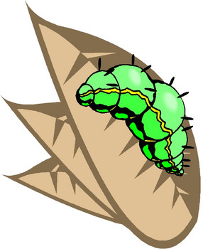

Polymorphism
Means many forms
Means that the method that is executed depends on the type of the object
  Often the method is determined by the type of the object at run-time
  This is called dynamic or run-time binding
TextBalloon
upperLeft
tailEnd
Message
drawTail()
SpeechBalloon
drawTail()
ThoughtBalloon
drawTail()

Slide 3
Adding a TextBalloon to a ComicPanel
Notice that ComicPanel has
  add(TextBalloon textBalloon)
  Adds it to a list of text balloons
The method will be called with both SpeechBalloon and ThoughtBalloon
  They are both types of TextBalloon so there is no problem with this
    Called Upcasting
TextBalloon
upperLeft
tailEnd
Message
drawTail()
SpeechBalloon
drawTail()
ThoughtBalloon
drawTail()

Slide 4
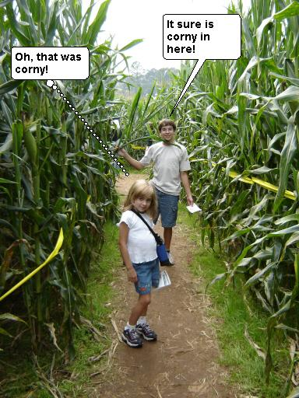
Run-time Binding of Methods
In getFinalPicture()
  Each element of the textBalloonList is told to draw
    And in draw each is told to drawTail()
  What method is called for each of the two types of TextBalloons?
    The SpeechBalloon
    The ThoughtBalloon

Slide 5
Finding the draw method
The java virtual machine will start looking for a draw method
  In the object that defines the class that created the current object
    Each object keeps a reference to the class that created it
  If the method isn’t found it will try the parent of the class that created the object
  And so on up the inheritance tree until the method is found
    It will be found or the code wouldn’t have compiled
      draw will be found in TextBalloon

Slide 6
Finding the drawTail method
The draw method calls drawTail
  Again the Java virtual machine will look for the method starting with the class that created the object the method was invoked on
    So for a SpeechBalloon object it will find it in SpeechBalloon
    And for a ThoughtBalloon object it will find it in ThoughtBalloon

Slide 7
How it works
TextBalloon
upperLeft
tailEnd
Message
width
draw(graphics g)
drawTail()
sBalloon:SpeechBalloon
upperLeft = objRef
tailEnd = objRef
Message= objRef
width = 100
class = objRef
tBalloon:ThoughtBalloon
upperLeft = objRef
tailEnd = objRef
Message= objRef
width = 100
class = objRef
SpeechBalloon
drawTail()
ThoughtBalloon
drawTail()
Notes:
The object called sBalloon is an object of the SpeechBalloon class and so it keeps a reference to the object that defines that class. The Java virtual machine will search for the draw method starting in the SpeechBalloon class and when it isn’t found will look in TextBalloon. It will execute that draw method. In the draw method it calls drawTail. Again the Java virtual machine will look in the SpeechBallon class first and find it there.
The object called tBalloon is an object of the ThoughtBalloon class and so it keeps a reference to the object that defines that class. The Java virtual machine will search for the draw method starting in the ThoughtBalloon class and since it isn’t there it will look in TextBalloon. It will execute the draw method in TextBalloon which calls drawTail. Again it will look for drawTail in ThoughtBalloon first and will find it there.

Slide 8
Adding a new Subclass
A whisper balloon has a dashed outline and small dim lettering. It indicates the character is whispering.
Create a WhisperBalloon class
  What class should it inherit from?
  What methods need to be overriden?
  How can you draw a dashed outline?
    Set the type of stroke to dashed
    See http://java.sun.com/docs/books/tutorial/2d/display/strokeandfill.html

Slide 9
Creating a Subclass
Use the extends keyword to say what class the current class is inheriting from
  If none specified inherits from java.lang.Object
  public class SpeechBalloon extends TextBalloon
  public class WhisperBalloon extends SpeechBalloon
    A whisper is still a type of speech

Slide 10
Creating a Subclass
Click on New and type the following
public class WhisperBalloon extends SpeechBalloon
{
}
Save it in WhisperBalloon.java
Try to compile it

Slide 11
Subclass Constructors
If the parent’s fields are private
  And they should be private
  You won’t be able to directly access them
    But you will still need a way to initialize them
You can use super(paramList)
  As the first line of code in a constructor
    To invoke the parent’s constructor with the same parameterList
If you don’t have this
  A call to super() is added for you by the compiler
    As the first line of code in the child class constructor

Slide 12
Add a Constructor to WhisperBalloon
SpeechBalloon doesn’t have a no argument constructor
  So you will need to add an explicit call to the parent’s constructor
import java.awt.Point;
public class WhisperBalloon extends SpeechBalloon
{
public WhisperBalloon (Point uLeft, int theWidth,
Point tEnd, String theMessage)
{
super(uLeft,theWidth,tEnd,theMessage);
}
}

Slide 13
Overriding Methods
If a subclass has a method with the same name and parameter list as a parent
  That will be the first method found when looking for the method
    It will be executed instead of the parent method
    This is called overriding a parent’s method
If you still want the parent’s method to be executed
  Use a call to super.method() to start looking
    In the parent class of the class that has the method with the call in it

Slide 14
What Method to Override?
We could override draw but do we need to?
  It has most of the functionality that we need
    Just need to save the current stroke, set the stroke to dashed, and reset it after doing the same as the parent drawBalloon
      In drawBalloon
    Just need to set the font to a smaller and plain font after we create a WhisperBalloon object
      In the constructor

Slide 15
Protected Visibility
Means subclasses and all classes in the same package have access
  A bit more private than public
  Used to override an inherited method
The public draw method calls 3 protected methods
  drawBalloon
  drawTail
  drawText

Slide 16
Exercise
There are other kinds of text balloons
  Some speech balloons only have a line to the speaker, not a triangle.
  Some speech balloons don’t draw the outline of the balloon in black.
  Some thought balloons use a cloud to enclose the text.
  A scream balloon has bold text and a spiny outline with a flash like tail. It indicates the character is screaming.
  Some speech balloons have a black background and white text
Pick at least one of these and implement it.
  Present what you did and why
Notes:
The speech balloon with a line instead is a kind of SpeechBalloon and can inherit from the SpeechBalloon class and override drawTail.
The thought balloon that is drawn with a cloud would inherit from ThoughtBalloon and override drawBalloon.
The scream balloon is a kind of SpeechBalloon and should inherit from that class and override drawBalloon and drawTail.

Slide 17
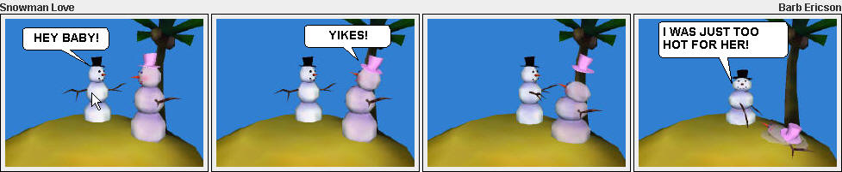
ComicStrip Class
Will display a comic strip with one or more ComicPanel’s in it.
Modify the main method to create your own comic strip
  You can use picture methods to make a black and white comic or one that looks like someone drew it in pencil

Slide 18
Summary
In analysis you try to understand the problem you are trying to solve
  What are the things involved?
  What is each responsible for?
In design you describe classes and their relationships
  In a UML class diagram
Inheritance is used to
  Pull out common things into a parent class - Generalization
  Allow a child to differ from a parent - Specialization
Abstract classes are used to allow for easy addition of new subclasses
  With some abstract method overriden by the child class
Polymorphism allows for the right method to be executed based on the run-time type of the object

